Slide 1


Slide 2
INTRODUCTION
Swiggy was founded in 2014 and is headquartered in Bangalore, India.
Rahul Jaimini(Co-Founder): IIT-KGP alumnus and chief technical officer, driving things from the very back end.
Sriharsha Majety(Co-Founder): IIM Calcutta & BITS Pilani alumnus, with a vision to revolutionize the restaurant industry in India, by familiarizing the general public with the comfort of home-delivered food.
Nandan Reddy(Co-Founder):MSc Physics (Hons.) from BITS Pilani with a penchant for great food and operational efficiency.

Slide 3
WHAT DOES IT DO?
Swiggy provides on-demand food delivery platform designed to provide food from neighborhood restaurants to the people.
The Company's platform utilizes a smartphone application that has local restaurants and their online ordering menu listed, from which it provides delivery using a fleet of personnel, enabling people to order food at their convenient places.

Slide 4
REVENUE & COSTS
Commission from Restaurants
Delivery Charges
Surge Prices
Advertisement
Advertisement
Marketing
Internet Traffic

Slide 5
FUNCTIONS
Administration
Branding and Communication
Business Development
City Operations
Customer Service
Finance & Accounts
Product Management

Slide 6
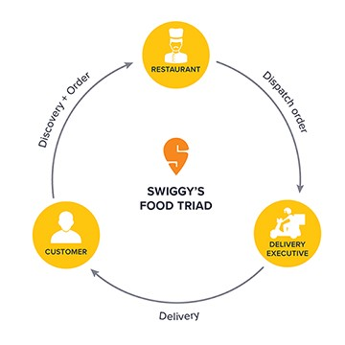
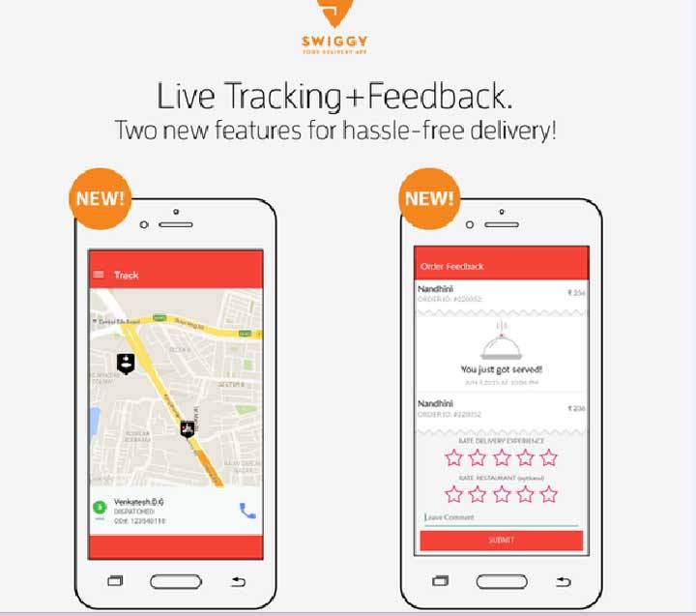
PROCESS

Slide 7
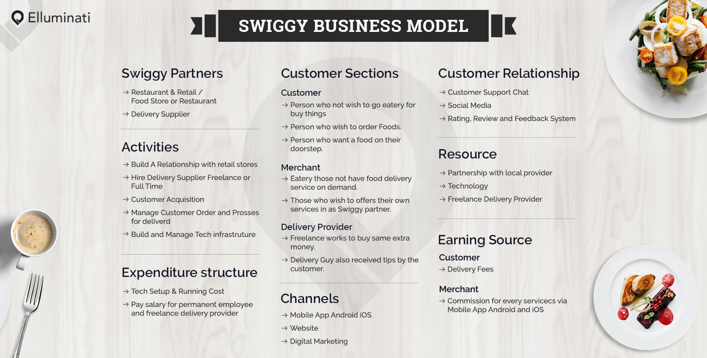

Slide 8
KPI’s and Metric
Bounce rate
Number of deliveries per hour
Average revenue per user
Avg.Monthly Visits
Avg.Visit Duration
Pages/Visits
Real competitive engagement metrics
Retention rate of competitors' apps
Patterns by hour and day
Audience Interests by app affinity

Slide 9
Analysis Implementation
Operations analytics
Customer experience
Operational efficiency
Fraud detection & prevention
Revenue model
Product analytics
User behaviour on platform
A/B testing
To setup real-time tracking
Marketing analytics
Acquisition
Retention
Google Analytics

Slide 10
Google Analytics
Website Analysis tracks traffic volume, engagement, geographic distribution and audience interests on desktop and mobile. Use this to analyze competitors or potential partners.
App Analysis provides rank, traffic and engagement data for any app, allowing you to benchmark yourself and to identify and qualify emerging players.

